Slide 1
Salesforce Testing Concepts
SALESFORCE TESTING CONCEPTS
Author: ASHWIJA DEV M.D
Date: 09/10/2019

Slide 2

Contents
Why Salesforce testing?
Levels of Testing in Salesforce
Salesforce Testing challenges
Roles and Responsibilities of a Salesforce Tester
Salesforce Exploratory Testing
Salesforce Load Testing
Salesforce Security Testing
Salesforce Test Automation
Conclusion

Slide 3
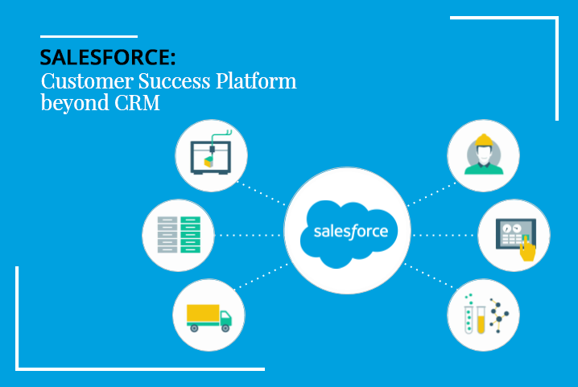
What is Salesforce Testing?

Slide 4
Salesforce.com is a CRM platform that provides multiple cloud services to manage your organization’s sales, marketing, and customer support, by providing helpful tools for administration of contacts, campaigns, reports, groups, calendars, accounts, and opportunities.
Being that Salesforce.com was a pioneer in the cloud, it has always provided a developer environment enabled for companies that wanted to customize their own data structures into the platform.
This ability to test and customize Salesforce.com is a great benefit to enterprise organizations, but also adds a great deal of complexity when consider how to test all of these potential permutations.
Salesforce testing requires the use of complex test methodologies as most of the features in Salesforce are built-in features that are customizable.
Salesforce is built on a platform development language named as APEX. The language provides built-in unit test cases for developers to test their own code. The standard rule of Salesforce requires a developer to achieve 75% of code coverage with unit test cases.

Slide 5
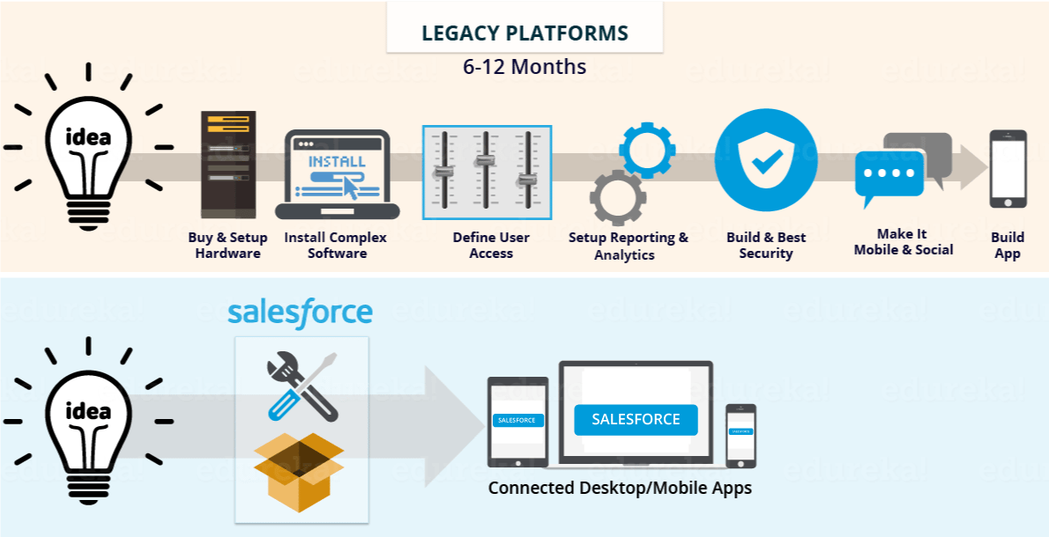
Why Salesforce testing?

Slide 6
Allows you to check that configuration and code is functional.
Helps you to verify that the finished system can support the client's business processes.
Helps you to confirm that the system's initial build meets the agreed requirement.
Functional flows report based on the status of test cases. This allows the team to create the functional flows to know the functionality of the application.
Process builders feature helps you to check the working condition and behavior of the system.
Workflows allow you to check the functionality of time-based events.
Allows you to troubleshoot a problem with automated rules in the system like workflow, validation, assignment, etc.

Slide 7
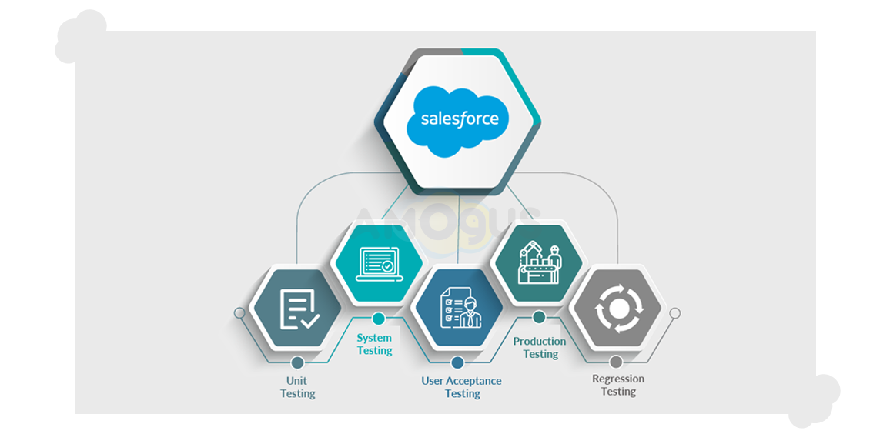
Levels of Testing in Salesforce

Slide 8
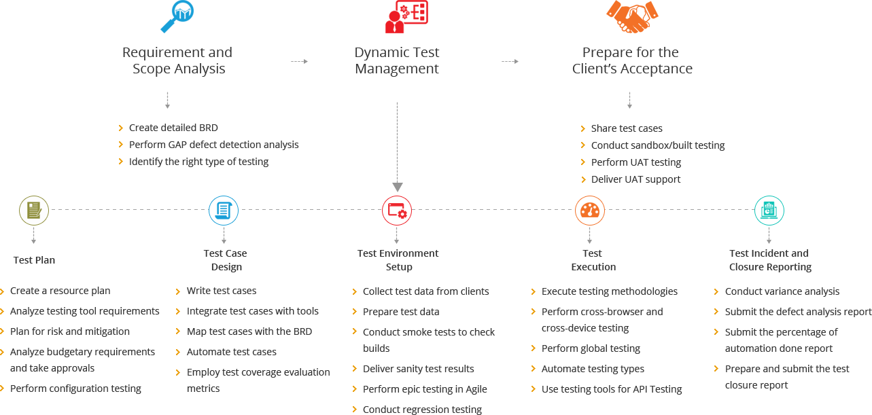
Salesforce Testing Process

Slide 9
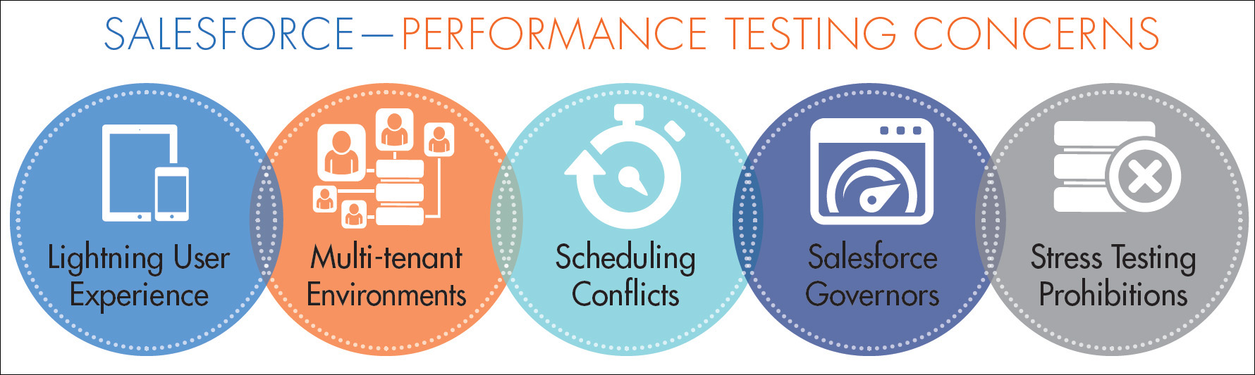
Salesforce Testing challenges

Slide 10

Roles and Responsibilities of a Salesforce Tester

Slide 11
A tester needs to have clear communication with the development team, to understand the customizable features that are being built into Salesforce.
The tester needs to coordinate with the business whenever required as the requirement document for Salesforce is usually complex to understand and requires a lot of effort to be understandable by the testers.
The tester needs to make sure that the code coverage does not go below 75% as per the standard Salesforce rule.
The tester needs to conduct role-based testing to ensure the consistency of data with various user roles.
The tester needs to perform compatibility testing of the third-party applications integrated with Salesforce if any.
A tester needs to be familiar with load testing tools such as JMeter to validate the complex flows that produce inconsistent results in Salesforce.
A tester needs to be familiar with multiple application flows.

Slide 12
Salesforce Testing Tips
Testing must include UI testing, functional testing, regression testing, integration testing, system testing and system integration testing.
A tester needs to be cautious during UI testing as most of the web pages on the Salesforce platform are Visual Force pages.
The dynamic nature of visual force pages need to be paid special attention as all the elements of a webpage may not be loaded at one go.
Testers need to create functional flows including positive and negative flows to cover the entire functionality of an application.
Workflows using various user roles must be constructed and tested.
Test cases need to be documented using a test management tool like Tracker.
Test Data needs to be prepared for validating the reports functionality.

Slide 13

Salesforce Exploratory Testing

Slide 14
Testing should involve validating the consistency of data across multiple screens.
Testing should involve negative test flows, such as deleting the default data generated and validating the behavior of an application.
Cross browser compatibility testing needs to be performed to ensure if the rendering of data is correct across multiple browsers.
Testing must include Maximum length validation for each of the editable input fields along with the invalid data validation.
Testing must also include error message validation when invalid data is passed onto the applications.
Reports and dashboard testing need to be paid special attention to various test data parameters.
Testing should include the entire application flow, along with individual functional flows.
Multiple permutations and combinations of functional flows can be tested for positive and negative testing.
API testing for integrated third-party applications needs to be performed.

Slide 15

Salesforce Load Testing
Test and Evaluate Performance of a Cloud-Integrated Salesforce App
The advantages of cloud platforms like Salesforce are in-time scalability and global availability benefits. There is no extra setup required other than creating performance testing goals and conducting those tests.
From the UI, identify areas of integration from the external services. The recommended strategy is to test the runtime performance of the application from UI when integrated with services.
Then, note these Integrations areas as performance test cases. Identify the HTTP method — “GET “or “POST” — that Salesforce is using.

Slide 16
Based on the method, determine if calls are made for fetching data or fetching and post-back to the external service
Identify the pages, modals, buttons, or search fields in the UI through which the above HTTP methods are called.
Another important part of performance evaluation is done in the areas of CRUD. From the UI, identify where create, read, update, and delete operations are called on custom or standard objects in the Salesforce application.
It is very important for an application to respond effectively while saving a record, fetching a certain number of rows from an object, updating the record that is already created, and deleting a record.
Again, identify the pages, modals, buttons, or search fields in the UI.
As Salesforce is a cloud-based platform, one can consider Web based tools (like Chrome Developer Tools, Firebug, Firefox, Fiddler) that have the ability to measure the network performance and runtime performance of the application.

Slide 17
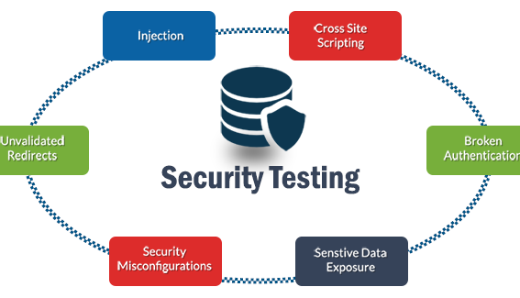
Salesforce Security Testing
Test and Evaluate Customer data Security
The Salesforce security team acknowledges the valuable role that independent security researchers play in internet security.
Salesforce is committed to working with security researchers to verify and address any potential vulnerabilities that are reported.

Slide 18
Security testing on the Salesforce platform is usually done by Salesforce development team. Before placing a request for a security test, it is best to review the ‘Application and Network Vulnerability Assessment Summaries’ provided by Salesforce.
After reviewing the summary, if a security test is still required, then a Security Assessment Test can be scheduled with the Salesforce team.
Force.com Security Source Scanner: Security source scanner is an on-demand static code analysis tool provided by Salesforce. This tool scans the source code that is provided as input and yields a summary report with the list of potential security vulnerabilities. Security source scanner requires a license to be used.
Force.com Secure Coding Library: This is a standard library provided by Salesforce that helps the developers to enforce the best coding practices in terms of security. Usage of this library helps the developers to reduce the risk of developing high-risk applications with security vulnerabilities.

Slide 19
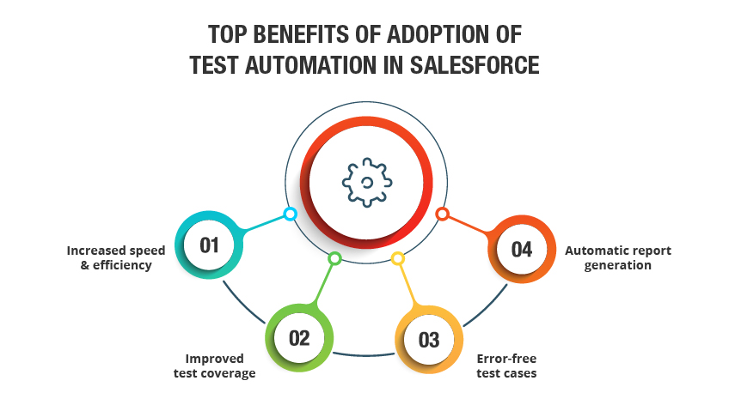
Salesforce Test Automation

Slide 20
Automated functional testing of Salesforce is a challenging one as most of the web pages are dynamic in nature on the Salesforce platform.
Hence, Salesforce demands automation testers to build robust automation framework to sustain in the future. Also, there can be frequent updates to the applications as they are on cloud applications.
Offers better Apex Test Execution, detailed test coverage, and class coverage reports.
Auto-generate test scenarios to run for different environments and multiple browsers.
Seamlessly record and playback your recorded test cases.
Helps you to automate all types of pre- and post-deployment tasks.
Salesforce testing process separate data from test script and allows you to enhance with multiple datasets.
Test Automation on Salesforce can be achieved using any of the following tools:
Selenium web driver
HP Unified Functional Testing (UFT)
Provar

Slide 21
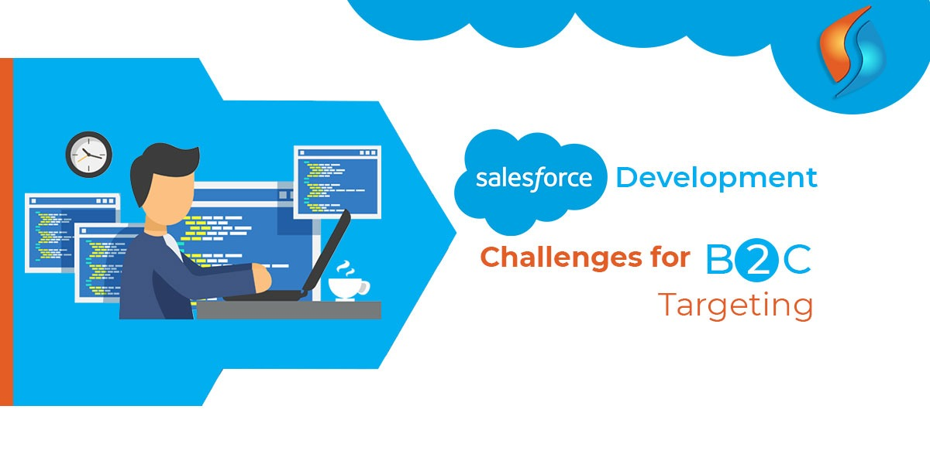
Salesforce Testing: Client Challenges

Slide 22

Conclusion
Salesforce has a dedicated community of developers and testers whom one can connect to in the hour of need.
Salesforce can be used using a web browser without the need to install additional hardware or software, which makes it the ideal choice for organizations worldwide.
Testers can opt for SalesForce.com administration certification and improvise their career on Salesforce platform.

Slide 23
Thank You
SALESFORCE TESTING CONCEPTS
Author: ASHWIJA DEV M.D
Date: 09/10/2019

